Slide 1
Introduction to Python
Dr. Jay Wang
July 2020

Slide 2

$ whoami
Software Engineer
Java
Project Manager
People
Systems Thinker
Systems
Data Scientist
Data Engineering
Python
Process
Technology
Systems of Systems
Complex Adaptive Systems
Cloud Computing
Data for Social Good
Data Visualization
wcj365.github.io
Notes:
I am a lifelong learner.
My interest: Data and Engineering for Social Good.
Apply Data Science and Systems Engineering to help improve society and humanity

Slide 3
Why Learn?
To live is to learn.
Notes:
Life is a Complex Adaptive System. One core nature of CAS is learning which make it adaptive.
Learning is at the core of AI – machine learning. Learn from historic data and new data. Learn from experience.

Slide 4
Why Code?
Coding is fun.
Notes:
And many makes a living coding.
A few makes a fortune coding.

Slide 5
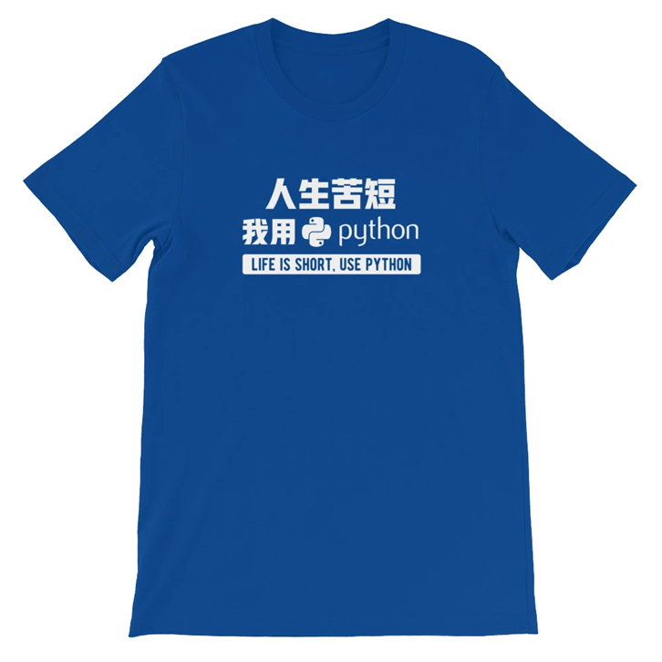
Why Python?
“Life is short (You need Python)”
- Bruce Eckel, author of Thinking in C++
- Bruce Eckel, author of Thinking in C++
Notes:
Python is among the top few languages.
It is simple. Elegant, flexible, powerful.

Slide 6



But I am a Systems Engineer, Why Me?
name a system that is not:
software-centric
and
data-driven
Notes:
A stone bridge is not the correct answer. “Modern systems”

Slide 7
The Plan
Audience
Interested in Python
Prior Exp. not Required
Local Env. not Required
Objectives
Code in Python
Use Linux/Bash Shell
Use Git/GitHub
Approach
Hands-on Practices
Eng. Best Practices
Cloud-hosted Env
Three One-Hour Sessions, Monday 8 – 9 AM
Notes:
Session 1 – we will use the Interactive Python Shell as the first environment to start our Python journey.
Session 2 – We will use Jupyter Notebook provided by notebooks.ai to explore Python. Jupyter Notebook is a web-based environment commonly used by data engineers and scientists. We will also use GitHub as the repository to store project artifacts including Jupyter notebooks.
Session 3 – We will use the Linux shell provided by notebooks.ai to write and run Python scripts/modules – This is for developing software using Python. Linux, Bash shell, Git, and vi will be introduced as essential tools for software engineering. We try to break away from the nice and cozy Windows environment and get more intimate with the real computer which has been obstructed by the fancy Windows desktop and the powerful mouse which tend to benefit business users but hinder hardcore engineers.

Slide 8
Preparation
python.org
Read about Python
Try Interactive Shell
GitHub
Create an account
Explore features
Google Colab
Create an account
Explore features
Notes:
GitHub has about 40 million global users and 100 million repositories.

Slide 9
Three Sessions
1. Elementary (Interactive Shell)
2. Exploratory (Jupyter Notebook)
3. Engineering (Python Modules)
Notes:
Data Science endeavor is exploratory and iterative by nature. So the iterative process of exploration can become disorganized and error-prone.
To better manage Data Science effort, you need the following tools:
An IDE that support exploration
A repository that support source code version and project management
A coding standard that promotes sharing, collaboration, and repeatability, transparency, and accountability
A defined workflow that guides the exploratory activities
IDE (Integrated Development Environment) – Desktop vs Web
Python’s bundled IDLE (Integrated Development and Learning Environment)
PyCharm (community and professional edition)
Spyder (IDE for data science)
Jupyter Notebooks (Web-based IDE for data science)

Slide 10
Session #1 – Elementary Python via Interactive Shell
Scalar Types & Operators
int, float, bool, None
=, +, - , *, / , %, ** (arithmetic)
Collection Types & Operations
string and string operations (strip, split, join, replace, find)
tuple, list, dictionary, set, range(start, stop, step)
In (relational, membership), comprehension
Conditions, Loops & Controls
Relational: ==, !=. >, <, >=, <=, and, or, not, is, in
If, elif, else,
for loop, while loop, pass/break/continue
Built-in functions & standard libraries
len(), type(), int(), str(), min(), max(), round(), range(),
os.listdir(), sys.path, math.sqrt(), math.pi
random - randint(), choice(), randrange(), gauss()
Notes:
Interactive interpreter = Python Shell = Interactive Python Shell
REPL = Read Evaluate Print Loop
Collection type is also called compound type.
Scalar type also called simple type.

Slide 11
Getting Help in Interactive Shell
>>> help(<module or function>)
Examples:
>>> help(len)
>>> import math
>>> help(math.sqrt)

Slide 12
Python Summary
Python is interpreted, not compiled
Python is dynamically typed, not statically/ typed
Python supports procedural, functional, and OOP
Python’s flexibility is both a blessing and a curse.
More friendly to learning and exploration
Less rigorous for software engineering.
Python is case-sensitive
Python index is zero-based
Python does not use curly brackets ({})
Use colon “:” along with indentation
Indentation can have any number of spaces
4 space indentation is the industry standard
Python interactive shell has limited functionality

Slide 13
Refresh and Repeat
String
Misc.
+ (concatenation)
strip()
split()
Join()
replace()
lower()
upper()
Substring via index and slicing
int(), str()
Assignment = vs Comparison ==
Relational: And, or, not, is, in
Input/print
Import <module>
from <module> import
list comprehension
try/catch/throw
break/continue/pass
Function/lambda

Slide 14
Session #2 – Explore Python via Jupyter Notebook
Cloud Env
- GitHub
- Google Colab
- Kaggle
Project Mgmt.
- Repositories
- Project Structure
- Markdown
More Python
- try/except/throw
- Input/output/format
- functions/lambdas
Notes:
Jupyter notebook is one of the many IDEs (Integrated Development Environment) – Desktop vs Web
Python’s bundled IDLE (Integrated Development and Learning Environment)
PyCharm (community and professional edition)
Spyder (IDE for data science)
Jupyter Notebooks (Web-based IDE for data science)
Talk about functional and OO programming.
- Built-in functions: abs(), round(), len()
- Functions from standard libraries: math.sqrt(), random.randint
- User defined functions: def func():

Slide 15
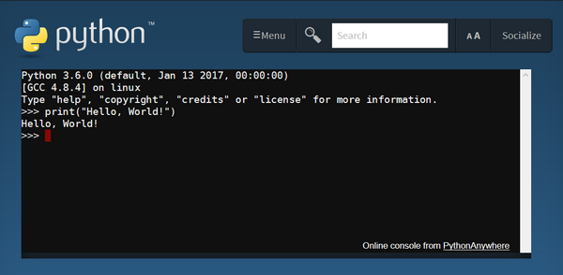
Interactive shell is helpful but limiting.

Slide 16
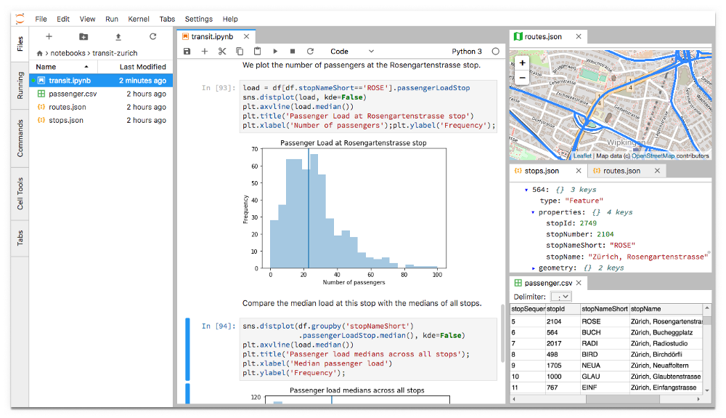
Welcome to the world of Jupyter Notebook

Slide 17
Getting Help in Jupyter Notebook
<module or function>? Click “Run”
<module or function>press shift + tab

Slide 18
Session #3 – Python Programs and Software Engineering
Command Line
Linux/Bash/Git
vi/ssh/scp
pythonanywhere.com
Coding Style
The Zen of Python
PEP 8
PEP 257
Python Modules
Scripts & Modules
Import Modules
Install Packages
Notes:
Linux, Bash shell, Git, and vi will be introduced as essential tools for software engineering.
We will break away from the nice and cozy Windows environment and get more intimate with the real computer which has been obstructed by the fancy Windows desktop and the powerful mouse which tend to benefit business users but hinder hardcore engineers.
Modularity for Code Reuse, Complexity reduction, and large-scale software development.
Zen of Python via import this
PEP 8 -- Style Guide for Python Code
PEP 257 -- Docstring Conventions

Slide 19

The view through a window is nice, but I would rather get my feet wet right now!

Slide 20

Welcome to the world of Linux!

Slide 21
Common Commands of Linux Shell
$ whoami
$ python --version
$ cat /proc/cpuinfo
$ cat /proc/meminfo
$ cal
$ date
$ pwd
$ cd
$ ls –al
$ cp, rm, rmdir, rm -r
$ ssh (secure shell)
$ scp (secure copy)

Slide 22
Basic Git Operations
One Time
Recurring
To start with a remote git repo
$ git clone <URL of a remote repository>
To start with a local dev folder
$ git init
Track changes in staging area
$ git add .
Commit changes to local repo
$ git commit –m “blah blah…”
Push changes to remote repo
$ git push –u origin master
Pull changes from remote repo
$ git pull

Slide 23
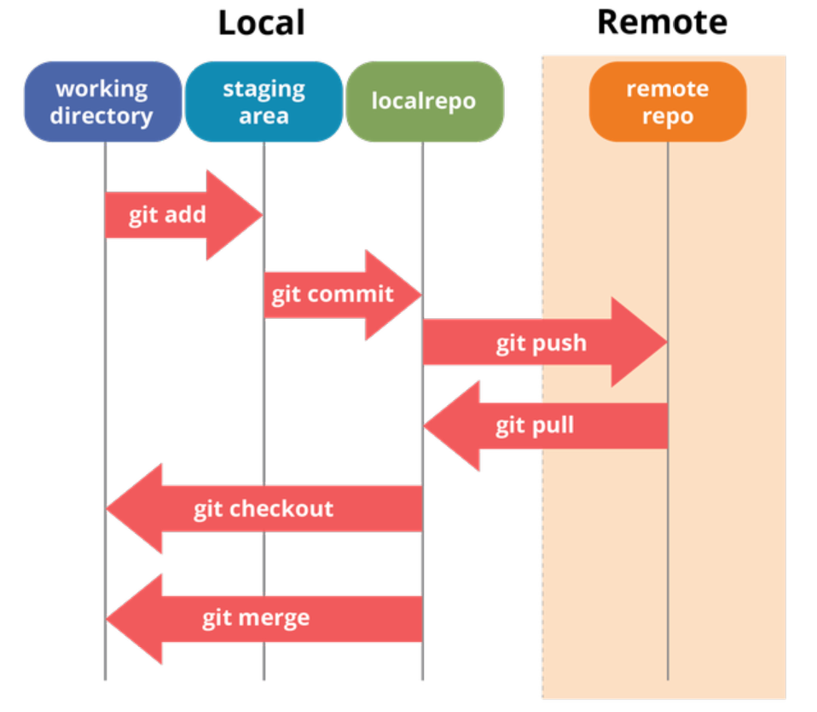

Slide 24
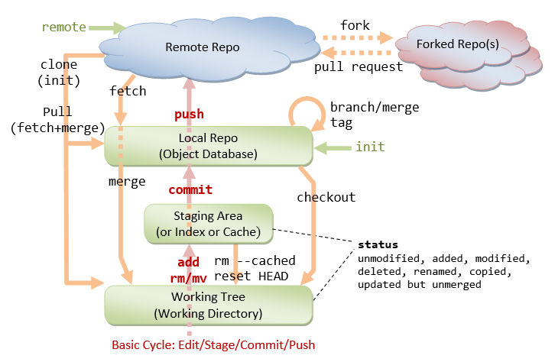

Slide 25
Practice #1 – Math Quizzes (Addition)
Write a program that generates 10 random quizzes on addition of two numbers
Numbers should be between 0 and 100
Display quiz like 2 + 5 = ? and check the user input
If non integer is entered, prompt for re-entry
If answer is wrong, allow the user to try 2 more times
if answer is correct, move on to a new quiz
At the end of the 10 quizzes, print a summary report
Display quizzes along with correct answers: 2 + 5 = 7
Display user answer only it is wrong: 2 + 5 = 7 (you answered: 8)
Display the number of correct answers: You fared 7 out of 10

Slide 26
Practice #2 – Math Quiz (Subtraction)
Modify the program in practice #1 for subtraction
Make sure the quizzes do not result in negative answers
Not valid
2 – 7 = ?
Valid
7 – 2 = ?

Slide 27
Practice #3 – Math Quiz (Multiplication)
Modify the program in practice #1 for multiplication

Slide 28
Practice #4 – Math Quiz (Division)
Modify the program in practice #2 for division
Make sure the quizzes do not result in fractional answers
Not valid
7 / 2 = ?
Valid
8 / 2 = ?

Slide 29
Practice #5 – Math Quiz (Modular)
Modify the program in practice #2 for modular operation
Make sure the first operand is not less than the second operand
Not valid
10 % 15 = ?
Valid
15 % 10 = ?

Slide 30
Practice #6 – Math Quiz (Squared Root)
Modify the program in practice #2 for squared root
Make sure the quizzes do not result in fractional answers
Not valid
Squared root of 10 = ?
Valid
Squared root of 9 = ?

Slide 31
Practice #7 – Math Quiz (All-in-one)
Consolidate all six operations (+, -, *, /, %, sqrt) into one product
For each quiz, randomly pick an operation from the six choices

Slide 32
Challenge
Scrape data from https://www.countries-ofthe-world.com
Build a list of countries and their capitals for reference

Slide 33
Practice #8 – Raffle
Use Python to Implement the Following:
Create a list of workshop participant names
Assign each a random # between 1 and the list size
Randomly pick one # from the list, do this 1000 times
Calculate the frequency of each # being picked
Print the name whose # has the most occurrences
If there are ties, repeat the random drawing

Slide 34

https://made4dev.com/products/life-is-short-use-python-t-shirt-for-developers

Slide 35
Next Step - Python for Data Science
Pandas for Data Analytics
Plotly for Data Visualizations
Dash for Interactive Dashboards
PySpark for Big Data Analytics
Notes:
Data Analytics, Visualization, ML, NLP : numpy, statistics, matplotlib, seaborn, plotly, sklearn, tensorflow, pytorch, kera, NLTK
Beginner’s Python for Data Science – 4-hour long training video:
https://www.youtube.com/watch?v=r-uOLxNrNk8&feature=emb_title&fbclid=IwAR0qJPcqezRICXAx1TAR28Ca5hrw_H9HkMOzyUWPFhyer4G2Lxxs4YdwYIY

Slide 36
Resources
Markdown
https://guides.github.com/pdfs/markdown-cheatsheet-online.pdf
https://commonmark.org/help/tutorial/
Bash/Git
https://github.com/dlab-berkeley/BashGit
https://about.gitlab.com/images/press/git-cheat-sheet.pdf
http://feineigle.com/static/books/2018/git_essentials/Git-Essentials.pdf
file:///C:/Users/cjwang/Downloads/essential_git_for_developers.pdf
Python
http://python.org
https://www.w3schools.com/python/default.asp
https://www.practicepython.org/exercise/2014/01/29/01-character-input.html
https://docs.python-guide.org/
https://github.com/dlab-berkeley/python-fundamentals
Python for Data Science
https://www.youtube.com/watch?v=r-uOLxNrNk8&feature=emb_title&fbclid=IwAR0qJPcqezRICXAx1TAR28Ca5hrw_H9HkMOzyUWPFhyer4G2Lxxs4YdwYIY

Slide 37
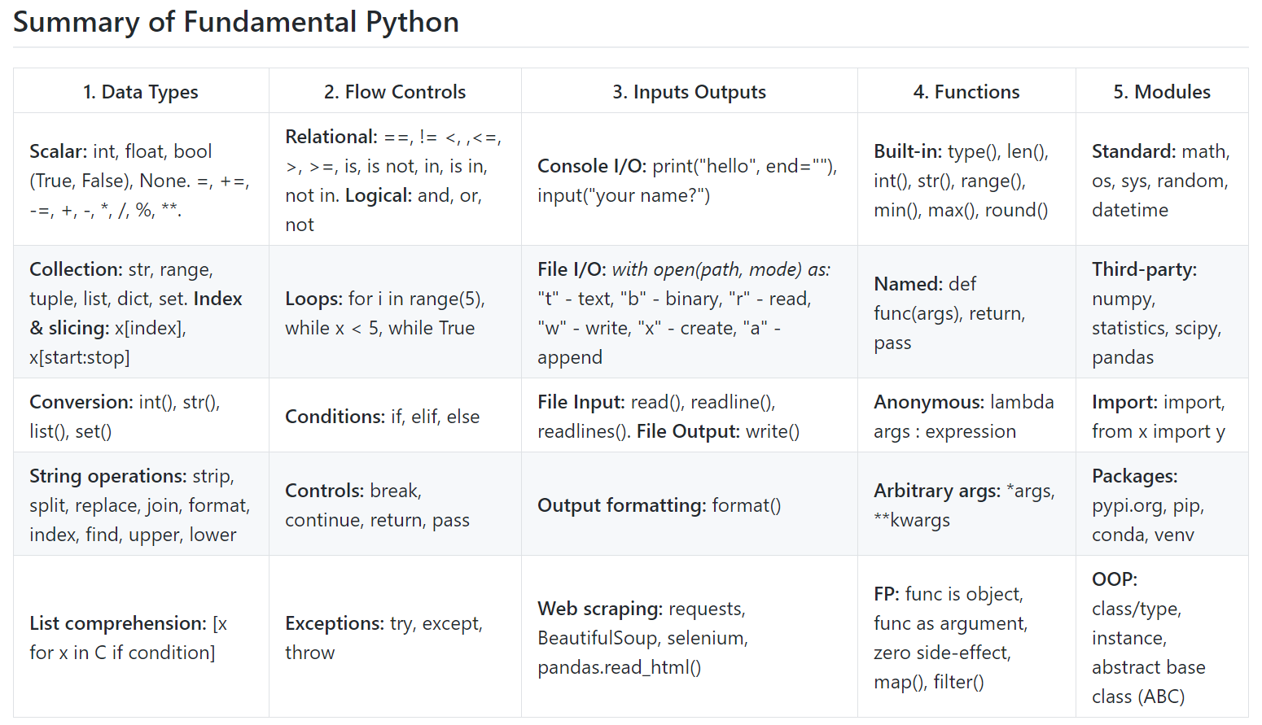

Slide 38
